Slide 1
Weijrn NFC manager
Created by Team Pupe6

Slide 2








Technologies

Slide 3
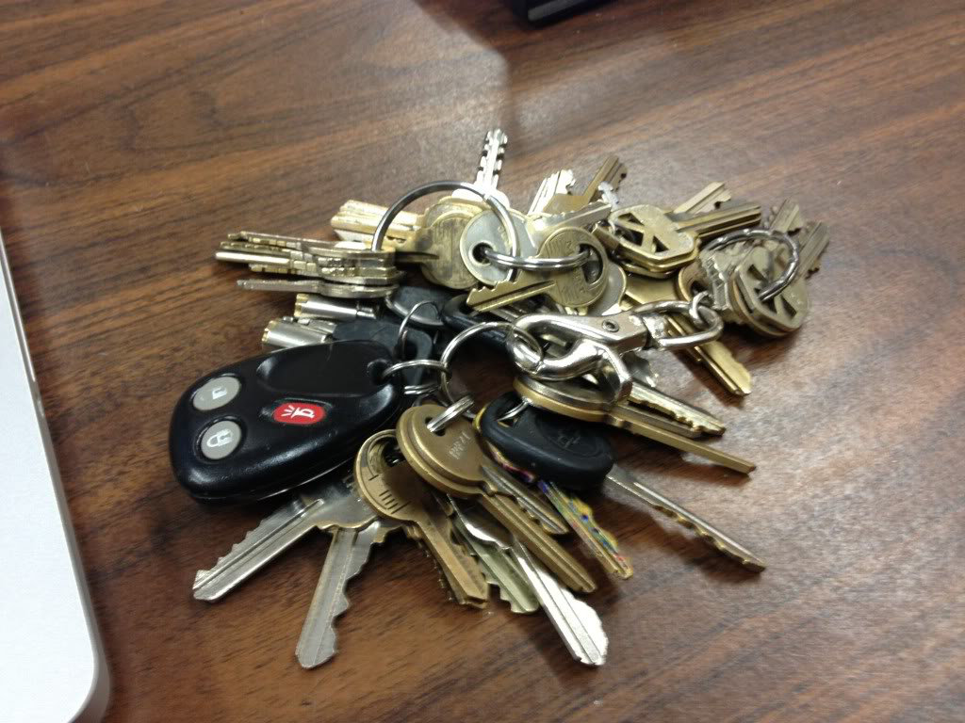
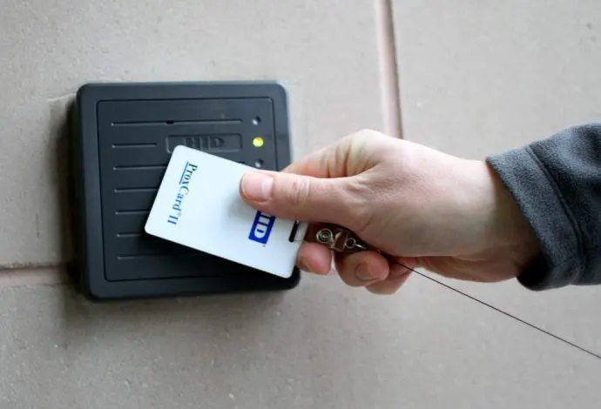
PROBLEM VS. SOLUTION
Problem
Solutions
-Too many keys for different doors.
-New employees don’t have access to all doors.
-Every key is expensive.
-Mobile app with requests for wireless keys for NFC cards.

Slide 4
DEMO

Slide 5
Updates for future
-Chat app for every user
-Groups of employess
-Hierarchy for all users in app with different abilities
-Timer for accessing all cards
-GPS tracker for remote tracking (JRN)

Slide 6
THANKS!
Please keep this slide for attribution.

